Slide 1
Qr code generator
TANISHQ TYAGI(2201990901)
AND
TANISH DALAL(2201990888)

Slide 2

WHAT IS PYTHON
Python is an interpreted, object-oriented, high-level programming language with dynamic semantics developed by Guido van Rossum. It was originally released in 1991. Designed to be easy and user friendly
it is used in many fields such as in:
Data science
Scientific and mathematical computing
Web development
Finance and training
Computer graphics
Basic game development,etc.

Slide 3
WHY PYTHON OVER OTHER LANGUAGES
There are many different types of computer languages such as jawa,c,c++,etc. However the reason to choose python for our project are:
Python works on different platforms (Windows, Mac, Linux, Raspberry Pi, etc).
Python has a simple syntax similar to the English language.
Python has syntax that allows developers to write programs with fewer lines than some other programming languages.
Python runs on an interpreter system, meaning that code can be executed as soon as it is written. This means that prototyping can be very quick.
Python can be treated in a procedural way, an object-oriented way or a functional way.

Slide 4
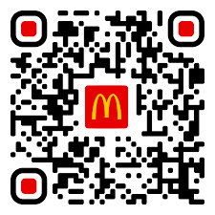
WHAT IS QR CODE
QR Code stands for Quick Response Code
It is a two dimensional bar code embedded with layers of information
It was originally created by a subsidiary of Toyota to track parts
Now used for mostly in commercial and marketing purposes
For example, this is a qr code of a famous
restaurant where it is being used for ordering
and paying for food by just scanning it.

Slide 5
coding
code
Code explanation
import qrcode
import image
qr = qrcode.QRCode( version=15, box_size = 10, border=5)
data="im making research paper of my project” qr.add_data(data)
qr.make(fit=True)
image =qr.make_image(fill="black",black_colour = "white")
image.save("test.png")
First of all, we need to download qrcode and image through pip in terminal,then we need to import it
Then we need to put cosmetics values such as box size,etc
Here we need to put in data for our qr code it can be either a link of some app or any other input()
Here we need to put in the background colours and qr code coluer
Now it is saved in form of png

Slide 6
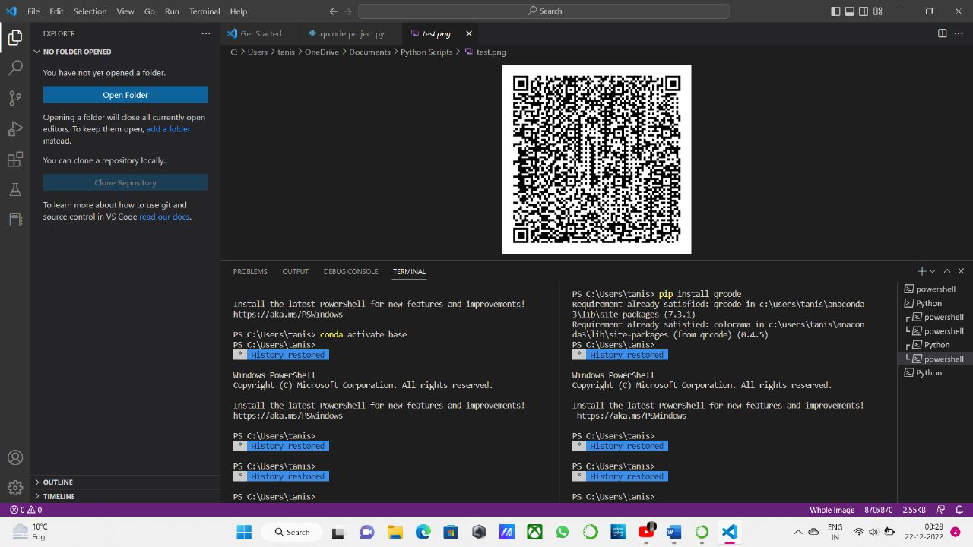
output

Slide 7
Advantages of qr code
QR codes promote sharing and networking: qr code can be used to link your social media profile directly with the other person for better accessibility
They can be used as a call to action: qr code can be linked to trailers,audio,commentary or videos, where scanning it can lead people directly to you
They can enhance your Social Media Optimization :it can help with your search engine optimization by increase in traffic to searchable objects and you can optimize them by encouraging even more sharing

Slide 8
Future scope
1)With time many businesses will be seen incorporating this technology to ensure smart operations.
2)in coming time QR codes will be used for coupon redemption alone. That only indicates a bright future for qr codes

Slide 9
Thank you
By tanishq tyagi(2201990901)
And
Tanish dalal(2201990888)

